Slide 1

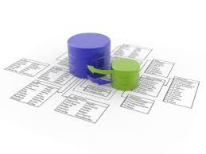


JavaScript Frameworks
JSF Course Program, Evaluation, Exams
Doncho Minkov
Senior Technical Trainer
http://minkov.it
Telerik Software Academy
academy.telerik.com

Slide 2

Table of Contents
What's Coming Next in the Academy?
The JavaScript Frameworks Course Program
The Trainers Team
Exams and Evaluation
Standard Criteria
Bonuses
Resources for the Course

Slide 3

JavaScript Frameworks
Coming To The Next Module

Slide 4

What's Coming Next?
A consequence of three web courses
JavaScript Frameworks
Building client SPA applications
ASP.NET Web forms
Building data-driven Web applications
ASP.NET MVC
Building data-driven Web applications

Slide 5
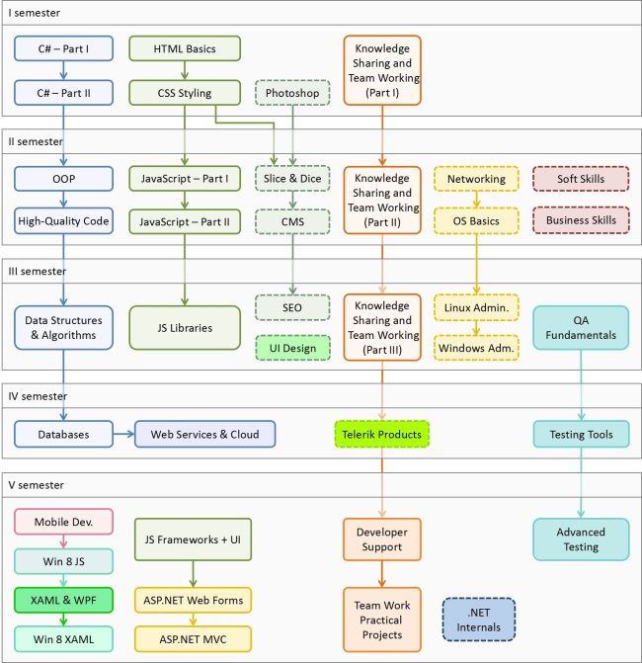

Web Programming Track
Software Academy Curriculum
Specialties @ the Academy
Success Stories @ Telerik

Slide 6

JavaScript Frameworks – Program
What Will We Cover in the JavaScript Frameworks?

Slide 7


The JSF Course Program
Underscore.js
Extension methods for JavaScript objects
Sammy.js
SPA apps with routes and templates
Mustache.js
String/html templates
Modernizr
Backward compatibility and feature detection
RequireJS
Lazy-loading of JavaScript dependencies

Slide 8
The JSF Course Program (2)
Single-page applications
Building SPA apps
MVC and MVVM design patterns
Architecture patterns overview
AngularJS
Controllers, views, routing, app life cycle
KendoUI and KendoMobile
ViewModels, views, binding, routing, life cycle
TDD with QUnit
Test-driven development of SPA applications

Slide 9

The Trainers Team

Slide 10
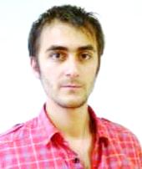
Trainers Team
Doncho Minkov
Senior Technical Trainer @ Telerik Software Academy
Informatics competitions contestant
Graduate from the first season of Telerik Software Academy
Email: doncho.minkov [at] telerik.com
Web site and blog: http://minkov.it
Twitter: @donchominkov

Slide 11
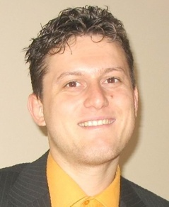
Trainers Team (2)
Svetlin Nakov, PhD
Manager Technical Training @ Telerik Software Academy
20 years software development experience
10+ years experience as trainer
Author of 6 books
Speaker at hundreds of events
E-mail: svetlin.nakov [at] telerik.com
Web site / Blog: http://nakov.com

Slide 12
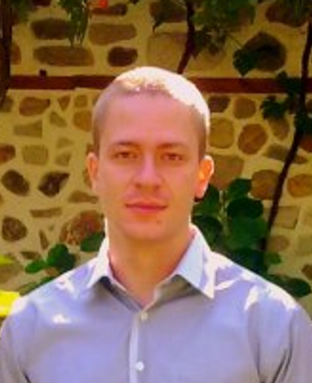
Trainers Team (3)
Ivaylo Kenov
Technical Trainer @ Telerik Software Academy
Math contestant
Champion from OOP and DSA courses
Email: ivaylo.kenov [at] telerik.com

Slide 13





Evaluation
Thank God There Are Bonuses!

Slide 14

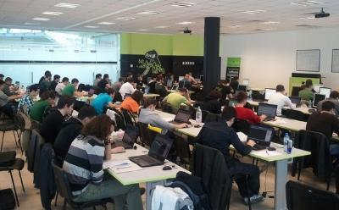
JavaScript Frameworks: Evaluation
Evaluation components
Practical exam – 60%
Teamwork – 15%
Homework – 10%
Homework evaluation – 5%
3 peer reviews per homework (excellent, OK, bad)
Attendance in class – 10%
Bonuses
Forums activity – bonus up to 10%
Helping new C# students – bonus

Slide 15


Pass / Excellence / Fail Criteria
Criteria for pass / pass with excellence / fail
Pass with excellence
Very high exam results
or
High total results
Pass
Average total results
Fail
Low total results or low exam results

Slide 16
Homework Peer Reviews
Everyone will get feedback for their homework
Everyone will give feedback for few random homework submissions
Students submit homework anonymously
Please exclude your name from the submissions!
For each homework submitted
Students evaluate 3 random homeworks
From the same topic, after the deadline
Homework comments are not obligatory

Slide 17
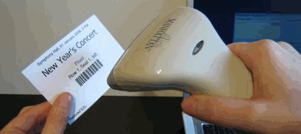
Check Your Presence
From now on you should check your presence on the barcode reader 3 times a day:
In the morning when lectures begin (~10:30)
After lunch break (~13:30)
When you leave academy halls (~19:00)

Slide 18








Resources
What We Need in Addition to this Course Content?

Slide 19

Course Web Site & Forums
Register for the "Telerik Academy Forums":
Discuss the course exercises with your colleagues
Find solutions for the exercises
Share source code / discuss ideas
The JSF official web site:
http://forums.academy.telerik.com/questions/front-end-development/javascript-frameworks
academy.telerik.com/student-courses/software-technologies/javascript-frameworks

Slide 20
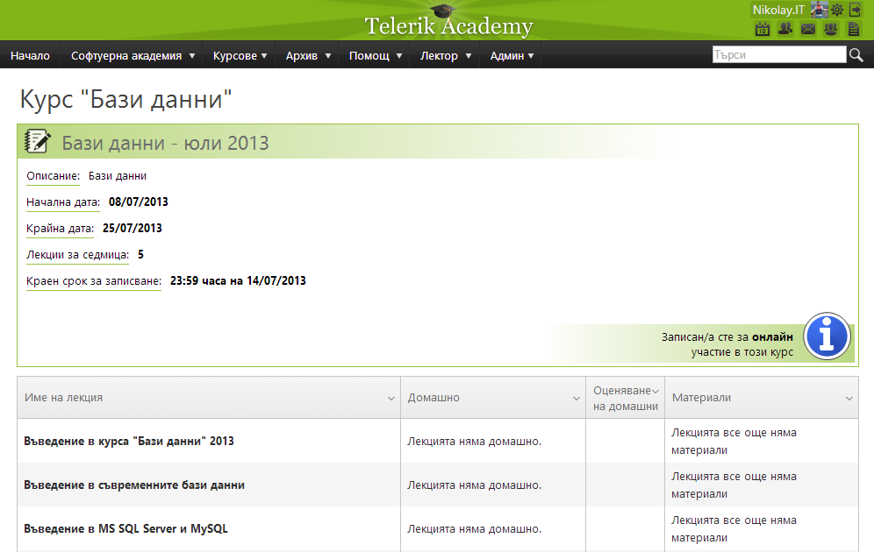
Telerik Integrated Learning System (TILS)
The Telerik Integrated Learning System (TILS)
www.telerikacademy.com
Important resource for all students
Homework submissions
Homework peer reviews
Presence cards with barcode
Reports about your results
telerikacademy.com/Courses/Courses/Details/110

Slide 21


Required Software
Software needed for this course:
Microsoft Visual Studio 2012/2013 or Visual Studio Express 2012 (free version of VS 2012)
Microsoft SQL Server 2012 Developer with Service Pack 1 and Developer Tools

Slide 22


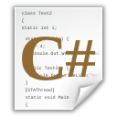


JavaScript Frameworks
http://academy.telerik.com

Slide 23




Free Trainings @ Telerik Academy
C# Programming @ Telerik Academy
csharpfundamentals.telerik.com
Telerik Software Academy
academy.telerik.com
Telerik Academy @ Facebook
facebook.com/TelerikAcademy
Telerik Software Academy Forums
forums.academy.telerik.com

